Slide 1

The Outreach Center for Deafness and Blindess
Promoting Access for People who are Deaf, Hard of Hearing, Blind, or Visually Impaired
Facilitator’s Guide
Notes:
The Outreach Center for Deafness and Blindness Mission
The Outreach Center for Deafness and Blindness increases access, communication, and equity for learners who are deaf, hard of hearing, blind, or visually impaired. We do this by connecting resources and providing training for professionals and fostering relationships to equip communities to support families and learners where they are, with what they need, when they need it to learn, grow, and live their best lives.
Guided by the belief that increasing access to information promotes independence, the Promoting Access for People Who are Deaf, Hard of Hearing, Blind, or Visually Impaired training module is a collection of introductory information, evidence-based strategies, and scenarios at home, at school, and in the community designed to build confidence and comfort for anyone communicating or connecting with people who are deaf, hard of hearing, blind, or visually impaired. Hear authentic perspectives from individuals, their families, community members, co-workers, educators, and others who touch their lives. From gaining insights, to learning basic strategies that can impact how a person receives information about their world using sensory information, this self-paced module combines important information together in one place.
Facilitator Tips
Reviewing the module will allow the facilitator to plan the training and understand the overall outcomes and goals pertaining to their audience.
Review the resources on the Additional Resources slide and prepare to highlight those that are most applicable to the participants and the modules.
Plan the pacing of the module session or sessions:
Prior to the session, outline the amount of time that will be spent on each section in order to maintain the time schedule.
Ask participants to introduce themselves and briefly explain what they hope to gain from the module/session.
Consider inviting personnel to participate in the training from your organization or create a multi-agency approach
Facilitator Talking Points provide additional information related to the bullet points on the slide
Facilitator Notes are points you may want to highlight and guidance for you as the facilitator as you lead others through the modules.
*Facilitator Notes and Facilitator Talking Points are located in the notes section of the slides*

Slide 2
Why Promoting Access is Important
Low incidence of people
Diversity
Information is acquired in different ways
Increasing access to information connects us, it empowers us, and it promotes independence.
Notes:
Facilitator Talking Points
The number of people who are deaf, hard of hearing, blind, or visually impaired make up a small percentage of our society, meaning the incidence is low. This means that a person’s only experience with a person who is deaf, hard of hearing, blind, or visually impaired may be through what they’ve seen on TV, in the movies, or on social media—showing one person, in one place, at one time, which limits our perspective.
The reality is that being deaf, hard of hearing, blind, or visually impaired can look different in many ways.
Information shapes our experiences and our experiences shape us. However, when vision or hearing is affected, part of the information is missing, and this can create hurdles.
Increasing access to information connects us, it empowers us, and it promotes independence. When we promote independence, people are able to grow, learn, and live their best lives.

Slide 3
Group Discussion: Let’s Get the Conversation Started
What direct experience have you had with a person who is deaf or hard of hearing at home, school or in the community? Describe the interaction(s). Describe your comfort level and how you felt during the interaction(s).
What direct experience have you had with a person who is blind or visually impaired? Describe the interaction(s). Describe your comfort level and how you felt during the interaction(s).
Notes:
Facilitator Note
Have one example ready to share to get things started. Your goal is to use this activity as a warm exercise to get the group more comfortable sharing their perspectives and insights before you begin the module and discuss strategies.

Slide 4
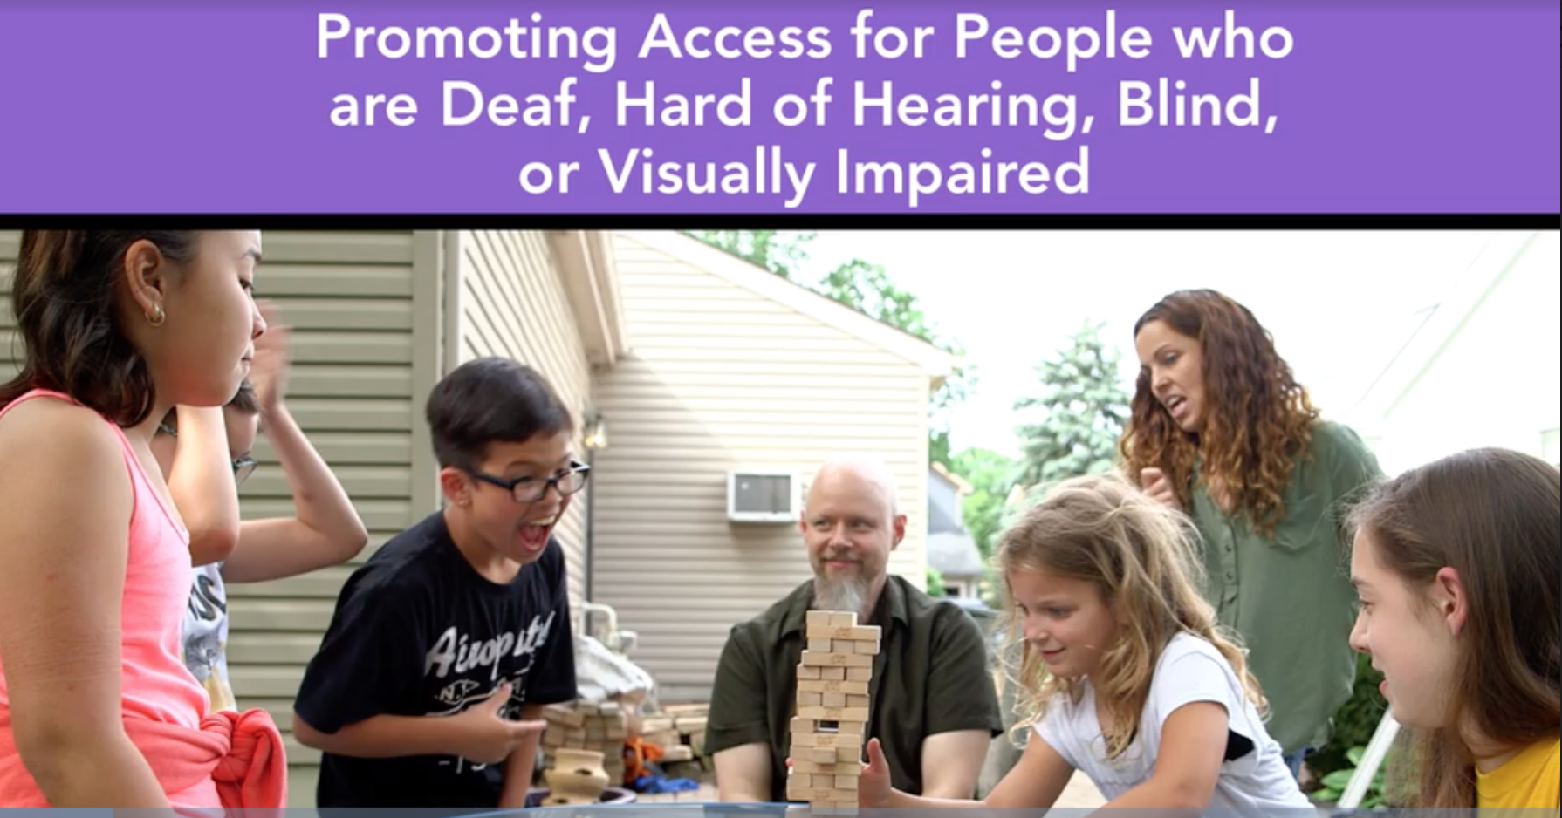
Promoting Access for People Who are Deaf, Hard of Hearing, Blind, or Visually Impaired training module.
To help parents, families, community members, and educators gain deeper insight into the factors that impact how a person receives information using sight, sound, and touch, the Outreach Center for Deafness and Blindness created the training module. Each video offers audio description and closed captioning viewing options.
Notes:
Facilitator Note
The Promoting Access for People Who are Deaf, Hard of Hearing, Blind, or Visually Impaired training module was developed in collaboration with multiple school districts and agencies across Ohio, and funded by the Ohio Department of Education, Office for Exceptional Children. This introductory training module is free and available to anyone, anytime.
Key Benefits to Using This Tool
Building confidence and comfort for anyone communicating or connecting with people who are deaf, hard of hearing, blind, or visually impaired.
Providing insights into factors that can impact how a person receives sensory information. You will also learn some basic strategies to improve access.
While other resources exist, few offer the opportunity to work independently or with a group at your own pace to build understanding around basic strategies to support people who are deaf, hard of hearing, blind, or visually impaired all in one module.
For those looking to extend their knowledge and learning on this topic, the Outreach Center offers face-to-face trainings that can be done in your school, district, or region.

Slide 5
An Overview of the Module
This free, self-paced video training module
Evidence-based strategies, scenarios at home, school, and in the community
Designed to build confidence and comfort for anyone communicating or connecting with people who are deaf, hard of hearing, blind, or visually impaired.
Notes:
Facilitator Notes
You will walk away with simple strategie you can use today and get answers to common questions such as:
How do I approach a person who is blind or visually impaired in a social setting?
How do I communicate with someone who is deaf or hard of hearing if I don’t know sign language?
What are some environmental considerations for making my classroom more accessible?
How can I increase opportunities for participation in my community?
What specific strategies can I use today?

Slide 6
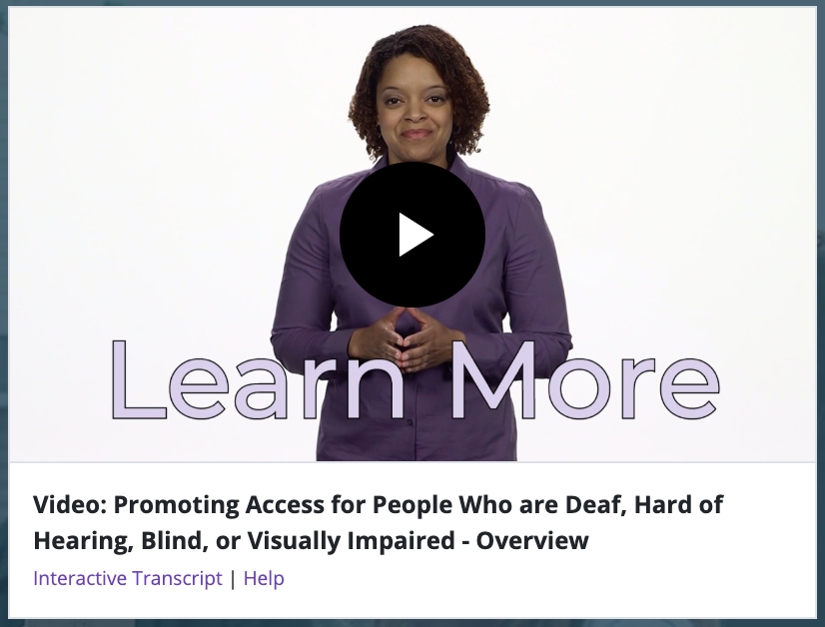
Overview Video
Notes:
Facilitator Note
In this 1:28 minute video, the host walks viewers through different features of the module. To access the video:
Click on the image of the host. This will take you directly to website.
Once on the website, scroll down to the picture of the host, click play, and enlarge to full screen (lower right icon).
Enable closed captions if needed (CC icon).

Slide 7
Module Format
Pre-Assessment: 12 questions used to measure the progress you make upon completing the module.
Introduction: Gain insight into factors that can impact how a person receives information using sight, sound, and touch. Discover simple and effective strategies to get you started with basic supports.
Notes:
Facilitator Note
This format overview gives the participants a general idea about what to expect for each section of the module and chance to ask any clarifying questions.

Slide 8
Module Format Continued (1)
Chapter 1: Establishing Relationships: The relationships we form with one another are an important part of our social and emotional well-being. Understanding how we are similar and how we are different enriches our interactions and strengthens our bonds.
Notes:
Facilitator Note
This format overview gives the participants a general idea about what to expect for each section of the module and chance to ask any clarifying questions.

Slide 9
Module Format Continued (2)
Chapter 2: Understanding Supports: Supports can come in many forms. Supports might be people, they might be ways our environment is structured, or they might be tools that are used for access.
Chapter 3: Access in Action: Observe these new strategies in real life scenarios at home, school, and in the community.
Notes:
Facilitator Note
This format overview gives the participants a general idea about what to expect for each section of the module and chance to ask any clarifying questions.

Slide 10
Module Format Continued (3)
Post-Assessment: 12 questions used to measure the progress you make upon completing the module.
Survey: Provide feedback about your experience with the module and what questions you may still have.
Notes:
Facilitator Note
This format overview gives the participants a general idea about what to expect for each section of the module and chance to ask any clarifying questions.

Slide 11
Let’s Get Started
Set up your account
Complete the pre-assessment
Review the introduction
Notes:
Facilitator Note
The first step to completing the module together is getting everyone registered. This process can take a little bit of time depending on the participant’s comfort level. The following slides are intended to provide visual support for each step of the process.
Once registered, each participant can being the twelve question pre-assessment and move onto viewing the Introduction (Time- 9:39).

Slide 12
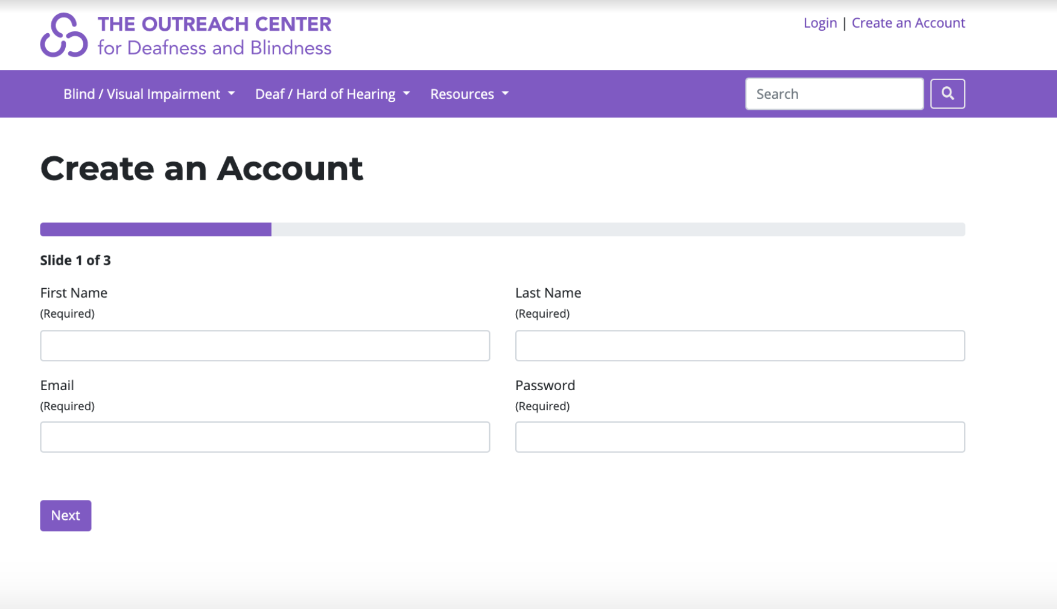
Setting Up An Account: Page 1
Go to https://deafandblindoutreach.org/create-account
Enter your name, email address, and create a password
Select Next
Notes:
Facilitator Note
All participants must register in the system (even those who already have an account with OCALI). The information does not expire and is available any time.

Slide 13
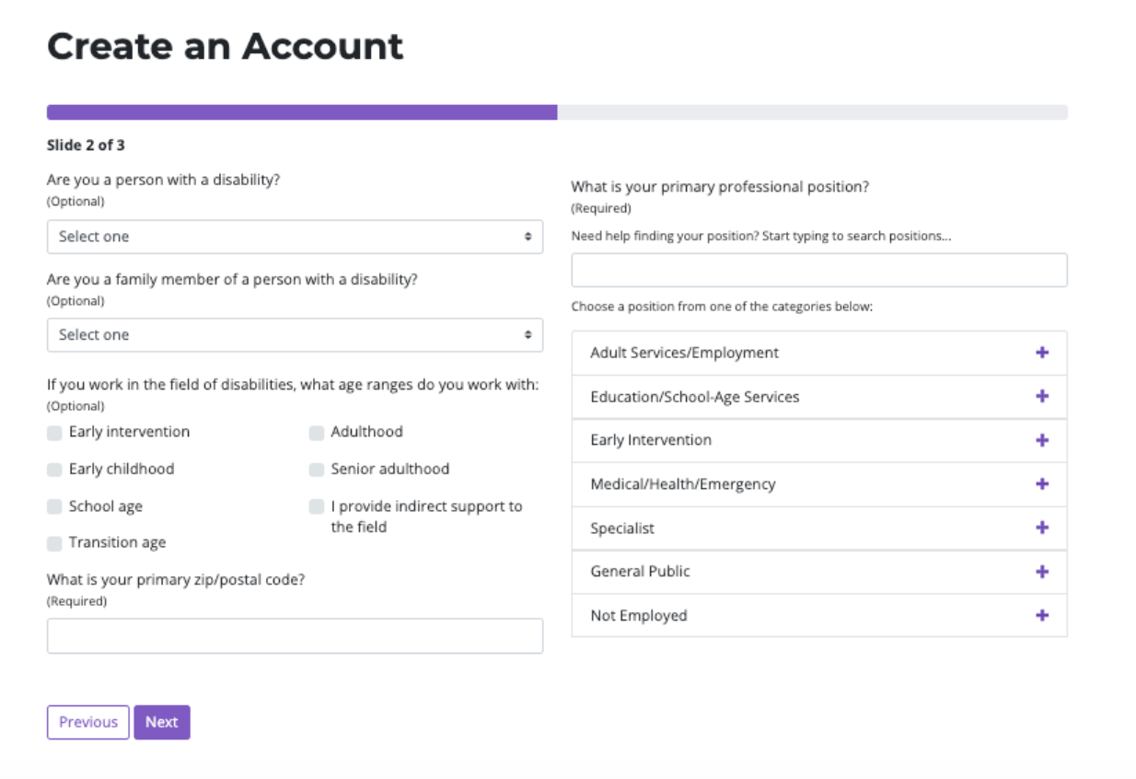
Setting Up An Account: Page 2
4. Answer the four demographic questions
5. Select Next
Notes:
Facilitator Note
The “What is your primary professional position?” question can sometimes be a challenge for people to answer depending on their day to day responsibilities. For those who struggle, encourage them to think broadly about the work that they do and select what feels most appropriate. There is no wrong answer.

Slide 14
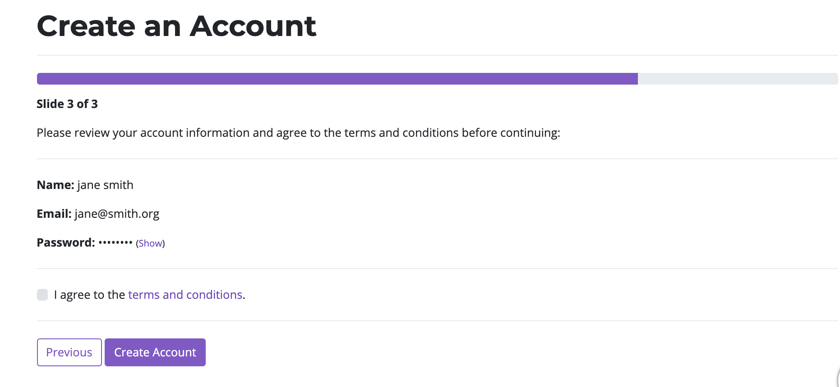
Setting Up An Account: Page 3
6. Select I agree to the terms and conditions
7. Select Create Account
8. Congratulations! You’ve set up an account you can access anytime.

Slide 15
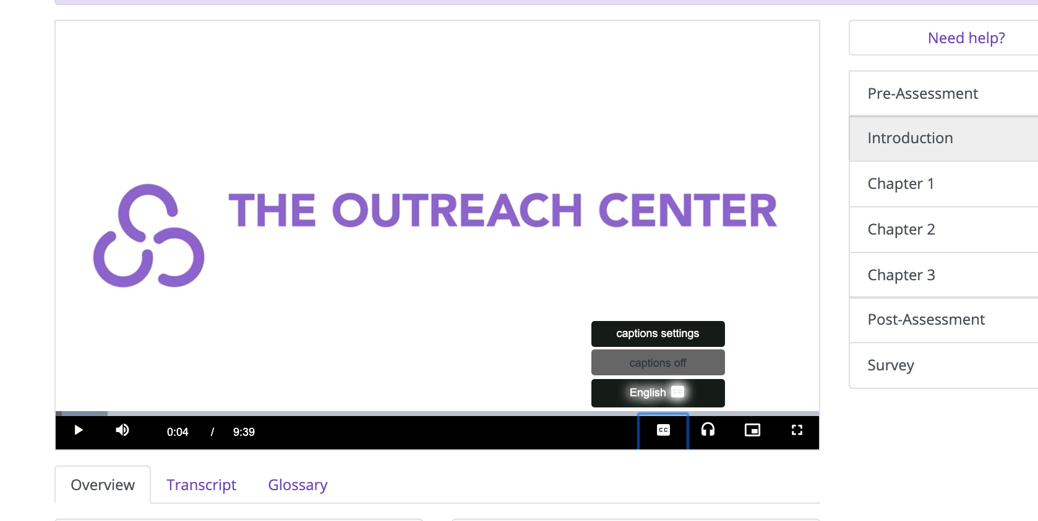
Pre-Assessment and Introduction video
Independently complete the 12 pre-assessment questions
Watch the introduction video
Once all have completed both, come back together as a group
Notes:
Facilitator Note:
Please note that closed captioning, audio description, and an interactive transcript are available for support while viewing the videos.
Bring the group back together once everyone has completed both the pre-assessment and Introduction.

Slide 16
Chapter 1: Establishing Relationships
Objective: You will increase your awareness of how to:
Develop social connections
Honor personal preferences
Enrich community connections
Watch Chapter 1
Notes:
Facilitator Note
Review the objectives
Watch Chapter 1 (Time-33:16)

Slide 17
Group Discussion: Chapter 1
How might content from this chapter apply in an environment where you live or work?
What’s one way you can share a strategy with others?
Notes:
Facilitator Note
Sample responses for the group discussion:
The content in the chapter can really help open some doors for connection in my community. My son plays football with another player who has parents who are deaf. I could use information from the chapter to share with other families to increase everyone’s comfort.
I work with a person who has a visual impairment and we have lots of meetings. I can start using the strategy, let others know when you enter and leave a room at our next meeting to let her know when I walk into the room. I’ll also make sure to mention the strategy to other staff members.
Reflection questions that included in Chapter 1:
What are some ways you can be prepared when interacting with someone who is deaf or hard of hearing?
Model Answer: Use a phone or pen and paper to write a message. (831-13:51)
Why is it important not to assume that someone who is deaf, hard of hearing, blind or visually impaired needs assistance in every situation?(1,428-23:48)
Model Answer: Asking if someone would like assistance, maintains the person’s autonomy.
What are three things you can do to help build social connections?
Model Answer: Approach the person, identify yourself, and let them know when you enter or leave a room. (1,876-31:16)
Strategies
Approach the person and identify yourself.
Be aware of your body language.
Let others know when you enter and leave a room.
Respect each person’s choice(s).
Be prepared
Allow time for processing information
Get involved
Be an ally
Share your experiences

Slide 18
Chapter 2: Understanding Supports
Objective: You will increase your understanding about how to:
Use a sign language interpreter
Provide sighted guide
Assess the environment
Watch Chapter 2
Notes:
Facilitator Note
Review the objective
Watch Chapter 1 (Time-32:51)

Slide 19
Group Discussion: Chapter 2
How might content from this chapter apply in an environment you live or work in?
What’s one way you can share a strategy with others?
Notes:
Facilitator Note
Sample responses for the group discussion:
A student in the school I work in is hard of hearing. She joined an after school club that I facilitate. I’m going to keep the information about considerations for the environment in mind when I’m planning our meeting space and activities.
My son works at a doctor’s office. I’m going to share the strategy, accessing interpreting services, so that she’s better prepared to talk about setting up an interpreter if someone needs it.
Reflection questions that included in Chapter 2:
What steps are involved in the interactive process when using an interpreter?
Model Answer: The steps involved include maintaining eye contact with the deaf person, speaking at your natural rate and pace, and to speaking directly to the deaf person. (644-10:44)
What types of information can be conveyed when providing sighted guide support?
Model Answer: Setting the pace, moving to the left or right, going up or down steps, stepping over something, going through a narrow space, alerting someone to things that might be at head or chest level (1,116-18:36)
Look around the room. What kinds of things do you notice that may cause auditory or visual distractions?
Model Answer: Answers will vary based on your setting, but may include music, laughter, lots of people moving around, loud conversations, etc. (1,913-31:53)
Strategies
Recognize the interpreter’s role
Understand the interactive process/Join the conversation
Access interpreting services
Offer assistance
Get moving
Arrive at the destination
Keep it safe
Reduce the noise/sound
Eliminating visual barriers

Slide 20
Chapter 3: Access in Action
Objective: You will increase your understanding of "access in action" in these situations:
Approaching others
Sharing your thoughts or asking a question
Providing sighted guide
Using a sign language interpreter
Watch Chapter 3
Notes:
Facilitator Note
Review the objective
Watch Chapter 1 (Time-24:06)

Slide 21
Group Discussion: Chapter 3
How might content from this chapter apply in an environment you live or work in?
What’s one way you can share a strategy with others?
Notes:
Facilitator Note
Sample responses for the group discussion:
I like that the scenarios shared are used at home and at school. Seeing all ten in action, and having time to think about what I could do, helped build my confidence.
I work with a student with visual impairment going into career tech program for information technology. The building, staff and students are new to her. I’m going to suggest that she share the resource with her instructors and other students to help build their awareness.
Reflection questions that included in Chapter 3:
Chapter 3:
Put yourself in the same situation. What may have been something that held you back? How can you apply what you’ve learned to take that first step to make a connection?
Model Answer: Answers will vary. The desire to do things the right way or uncertainty about how to begin may have been things that held you back. (584-9:44)
How are you more confident in approaching a person to offer support in different situations?
Model Answer: Answers will vary. Share your answers with a colleague. (976-16:16)
What are some things you can share with family members, co-workers, and others around you that will help eliminate distractions and keep everyone safe?
Model Answer: Pay attention to the set-up of the room, identify yourself, take turns communicating your message, and allow for processing time. (1,215-20:15)

Slide 22
Things You Can Do
Encourage agency staff and stakeholders to complete the module
Promote module use with family and friends
Share information about your efforts
More ideas?
Notes:
Facilitator Talking Points
Using your internal communication channels, market the Promoting Access for People Who are Deaf, Hard of Hearing, Blind, or Visually Impaired online module to agency staff is a free resource that they can personally use to improve their personal and professional interactions with people who are deaf, hard of hearing, blind, or visually impaired.
Let family and friends know about the training and encourage them to consider completing it.
Report back on your efforts—what did you do? What worked and didn’t work? What other resources do you need? Your feedback will help us strengthen the training, and better support you in your efforts to help promote the training.
More ideas? - have group members share additional things they can do in their communities or organizations

Slide 23
Additional Resources
For additional resources and information to help you and others continue to promote access check out the websites for:
The Outreach Center for Deafness and Blindness https://deafandblindoutreach.org/
OCALI
https://www.ocali.org/
Notes:
Facilitator Note
Review the links and identify additional resources that can be shared with the audience. If you’d like additional support please reach out to staff at The Outreach Center for Deafness and Blindness on the Center at https://deafandblindoutreach.org/about-us/who-we-are

Slide 24
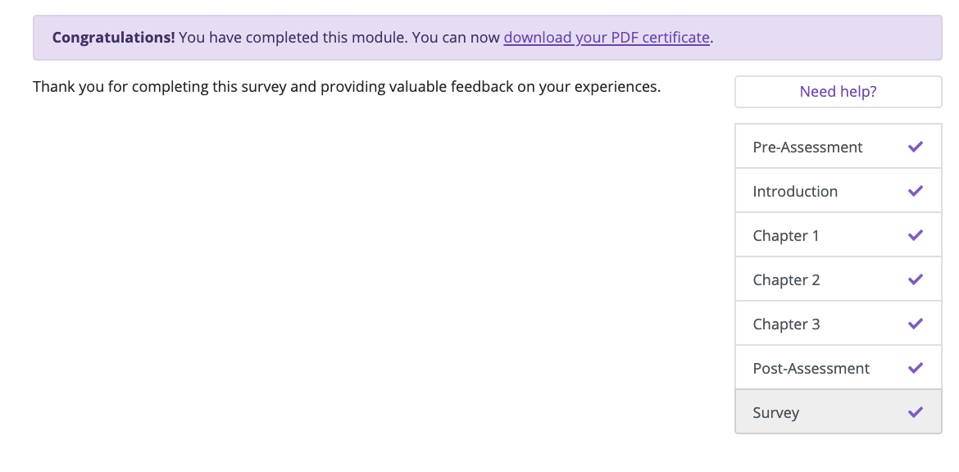
Post-assessment, Survey, and
Certificate of completion
Independently complete the 12 post assessment questions
Complete the survey
Once finished, your certificate of completion will be available

Slide 25
Thank You!
Visit us at
https://deafandblindoutreach.org/

